Slide 1
The Method Update Rule-- 2017
Does this affect me? HOW?

Slide 2

Method Updates
Standard Methods updated to reflect those published in the 22nd Edition
  Method number with the year of publication
      The method for BOD/CBOD is SM 5210 B-2011

Slide 3
Standard Methods
Updated methods refer to quality control sections
  1020—Chemical and Radiochemical analyses
  2020—2000 Methods (Turbidity, Acidity, Hardness, Solids, etc.)
  3020— 3000 (Metals) and 4000 (Inorganic Nonmetallic Methods
  9020—Microbiology

Slide 4
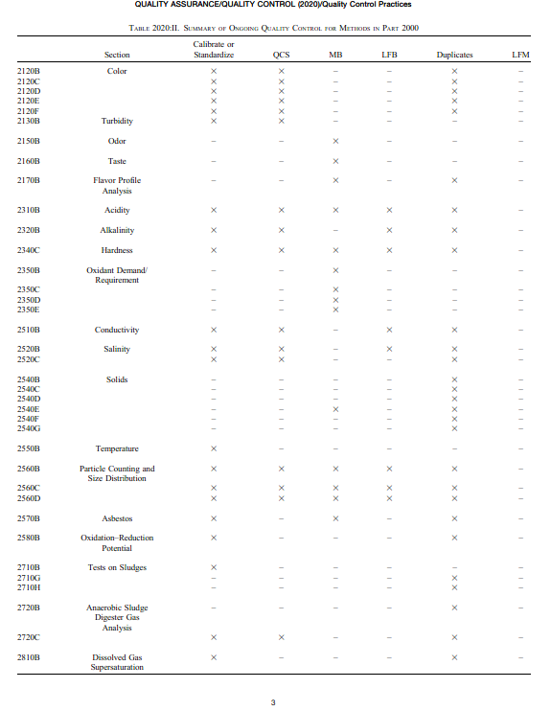

Slide 5

Micro Methods
Some changes to SM 9222B (Standard Total Coliforms)
  Allows use of humidified incubator
  Added a note in Procedure section 4.5f that at least 5 typical and atypical colonies must be verified per membrane
  The calculation of coliform density (Section 5b “Water of other than drinking water quality”) has been modified to be more like the EPA Microbiological counting rules

Slide 6
Micro Methods...
SM 9222D-2006 “Thermotolerant (Fecal) coliform Membrane Filter Procedure”
  Footnote 30 was added to Table IA, requiring on a monthly basis, at least ten blue colonies from the medium must be verified using Lauryl Tryptose Broth and EC both

Slide 7
Updated EPA Methods
Pesticides and PCBs: 608 is now 608.3
  Includes additional analytes
  Allows for alternate detector;
  Requires confirmation of identification
  Added reporting limits
  Allows for SPE
  Allows for method modifications

Slide 8
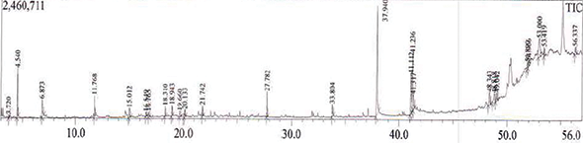
VOA and SVOA Organics
Volatiles--624 is now 624.1
  Expanded scope to include additional analytes
  Allows for method modifications
  Allows for flexibility
Semivolatiles—625 is now 625.1
  Changes are very similar to those in 624.1

Slide 9
ASTM and USGS Methods
Approval of new versions of currently approved ASTM Methods
New USGS Methods for the “Colorimetric Determination of Nitrate Plus Nitrite in Water by Enzymatic Reduction, Automated Discrete Analyzer Method”

Slide 10

Approved ATPs
IDEXX Laboratories, Inc., Colilert 18 for Fecal Coliforms in Wastewater—addition of increased incubation temperature for fecal coliforms, which requires the use of a water bath
HACH 10242: “Simplified Spectrophotometric Measurement of TKN in Water and Wastewater”
HACH 10206: “Spectrophotometric Measurement of Nitrate in Water and Wastewater”
Remember IDOPs!

Slide 11

Corrections made to the 40CFR
Typographical errors, technology updates, etc.
  Whole Effluent Toxicity Acute and Chronic Methods Manuals—clarifications in the definition of terms, consistency corrections among all three manuals.
  Table II, Required Containers, Preservation Techniques, and Holding Times
    Sodium thiosulfate concentrations for bacterial tests have been changed from 0.0008% to 0.008% sodium thiosulfate

Slide 12

Corrections/Clarifications
Alternative Test Procedures Section: error in 2012 Method Update Rule appeared to give State permitting authorities the authority to approve ATPs for limited use.
  This was never the intent
  Only the Regional ATP Coordinator can approve the limited use of ATPs

Slide 13
Why a New MDL Determination Procedure?
Addresses problems with the current procedure
  Blank contamination
  Long-term variance
  Actual detectability
Reduces false positives due to background contamination
An option to have MDLs that represent multiple instruments

Slide 14
MDL Determination
Basics remain the same:
MDL – the lowest result that reliably indicates the analyte is in the sample
Calculation is unchanged
The entire analytical process is incorporated—extraction, digestion

Slide 15
How is it different?
  Definition has changed slightly...
    OLD--“99% confidence that the analyte concentration is greater than zero...”
    NEW—”99% confidence that the measured concentration is distinguishable from method blank results...”

Slide 16
Inclusion of Method Blanks
Low Level Spikes AND method blanks are analyzed over multiple days (at least 3) and multiple instruments
An MDL calculated using the mean and standard deviation of MB results is compared with the MDL calculated from spiked samples
The greater MDL is used as the “Reported MDL”

Slide 17
Initial Determination of MDL
Blanks: Analyze at least 7 method blanks over a minimum of 3 days. Existing data is preferred;
Calculate the MDL_{B} using the formula:
MDL_{B} = mean +(SD)(Student’s t value)
MB results must be numerical; may be POSITIVE or NEGATIVE
Use “Zero” for the mean if it is negative
If all MB results are Non-detect (no peak on a chromatogram) the MDL_{B} does not apply

Slide 18
Spiked Samples...
Prepared and analyzed over at least 3 calendar days
Calculate the MDL_{S} as per usual:
MDL_{S} = SD(Student’s t value)

Slide 19
Compare results
The reported MDL will be the greater value– MDL_{B} or MDL_{S}

Slide 20
Ongoing Data Collection
Only use data associated with valid calibrations and batch QC
Analyze at least two spikes (in separate batches) on each instrument per quarter for a total of at least 7 per year. Spike at the same concentration as the initial MDL spikes
  IF > 5% of the spikes are not positive numerical results that meet method identification criteria, increase spiking level and re-determine initial MDL

Slide 21
Collection of MB Data
Analyze at least 7 blanks per year
  Use routine MB that are part of batch QC from the last 24 months
  If the number of MB>100, may use the 50 most recent results or those generated within the most recent 6 months—whichever is greater

Slide 22
Annual Verification of MDL
Every 13 months using the collected data from the past 24 months
  MB from the past 24 months
  Spiked samples at the same concentration as initial MDL spikes
  Include the initial MDL spikes if generated during the 24 month time frame

Slide 23
Re-calculate the MDL_{B} & MDL_{S}
The verified MDL is the greater of the two values
If the verified MDL is within 0.5 to 2.0 times the existing MDL, and fewer than 3% of the MB results have numerical results above the existing MDL, then the existing MDL may optionally be left unchanged.
Otherwise, adjust the MDL to the new, verification MDL

Slide 24
MDL Procedure
Implementation Issues
Different process, new mind-set!
Remembering to analyze quarterly spikes
Keeping up with the data
Possibly hundreds of method blank results to consider
Multi-analyte tests such as volatiles, semivolatiles a bit cumbersome
Learn the calculation rules

Slide 25

When will the MUR be approved?
The MUR goes into effect 30 days after publishing date in Federal Register
No estimated publication date!

Slide 26
How long will I have to implement the changes?
Begin addressing the changes immediately
New methods such as 624.1, 625.1, and 608.3 take time to learn and implement
To implement MDL guidelines will not be instantaneous

Slide 27
The MUR of ????
Approval of updated methods
Some “old” methods are going away—608, 624, 625→608.1, 624.1, 625.1
Approval of ATP methods: IDEXX for fecal; HACH 10242 for TKN; HACH 10206 for Nitrate
Need to perform an IDOC for any new methods
The new procedure for MDL determination

Slide 28

Questions?
semberskip@adeq.state.ar.us
For your attention!

